Slide 1

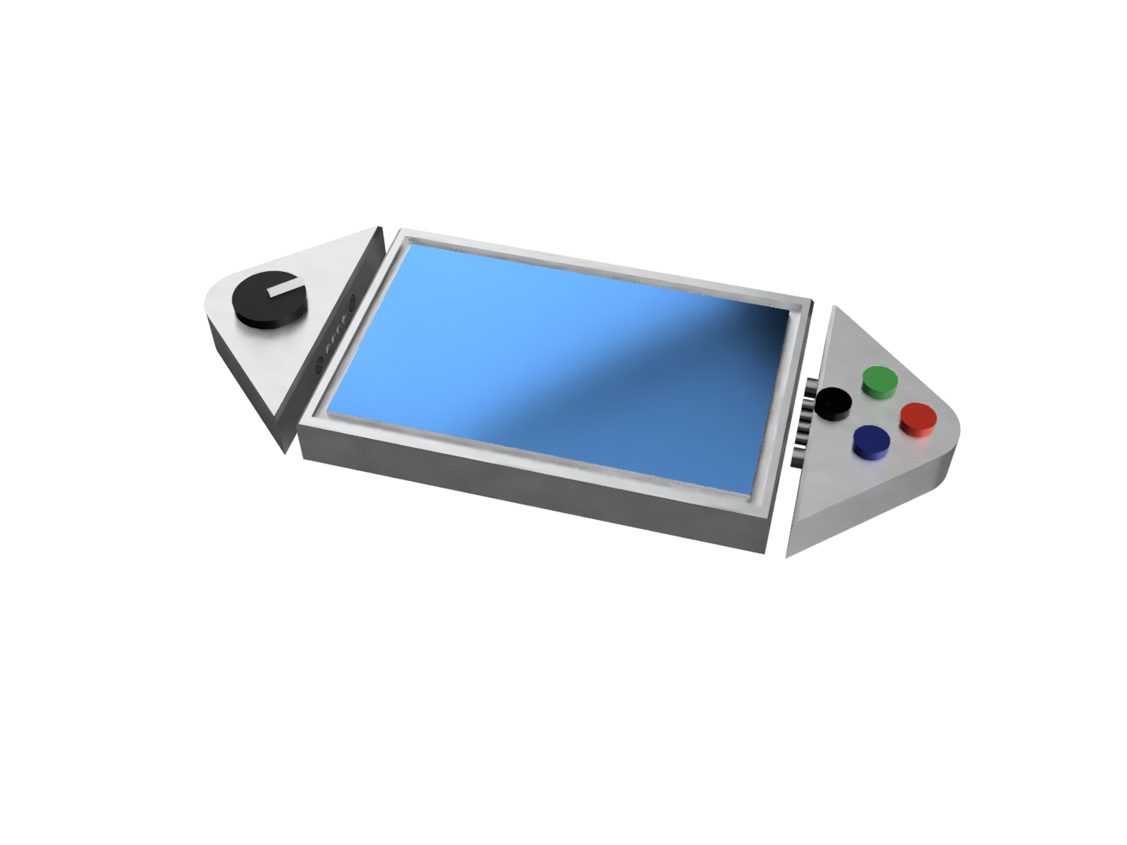
A plug and play panel with a start-to-finish user interface development experience
Software Support
Embedded System
User Designs Layout
Init Components
Convert to embedded code
Draw Static Images
Communicate with device
Init Components
Poll Auxiliary Components
Interface with user
Update Console
Design Challenges
Compatibility with multiple MCUs
Generating working embedded code
Controlling user system
Key features
Napkin-to-UI
No embedded knowledge needed
Plug and Play design
Serial communication protocol
Interchangeable tactile buttons, knobs, and sliders
Dedicated power supply

